Slide 1
HOUSING PRICE PREDICTION
Gargi Rajadnya
Maryam Amir Ahmad
Prerana Sahu
Notes:
Maryam

Slide 2
OBJECTIVE
Building a Housing Price Prediction Model for Houses in 77 zip codes of WASHINGTON, USA using Machine Learning in Python
Notes:
Maryam

Slide 3
INTRODUCTION TO TIME SERIES AND FORECASTING
Forecasting: Predicts future as accurately as possible, given all the information available.
Time series forecasting analyzes time series data using statistics and modeling to make predictions and inform strategic decision-making.
We have used a dataset containing 16 explanatory variables related to almost every aspect of residential homes in Washington DC
Some descriptive statistics and data visualization, fit some machine learning models to predict the housing prices and find which aspects of the house influence the housing prices mostly.
Notes:
Prerana

Slide 4
OVERVIEW
DATA PRE-PROCESSING
Check for null values, drop insignificant and irrelevant columns, clean the data, checking assumptions, etc.
CORRELATION AND DESCRIPTIVE STATISTICS
Correlation between the response variable and independent variables, visualization, relevant statistics, etc.
PREDICTIVE MODELING
Prediction of the housing prices based on the independent variables. Linear Regression, Decision Tree Regression and Random Forests were used. ML Model that will predict house price based on certain specifications.
CONCLUSION
Conclusion based on Predictive Modeling
Notes:
Gargi

Slide 5
CONCEPTS AND DOMAINS USED:
Machine Learning:
Tom Mitchell(1998): A computer program is said to learn from experience E with respect to some task T and some performance measure P, if its performance measure by P, improves with experience E.
E.g.: Filtering spam emails.
The main two types of Machine Learning:
Supervised learning and
Unsupervised learning.
Notes:
Gargi

Slide 6
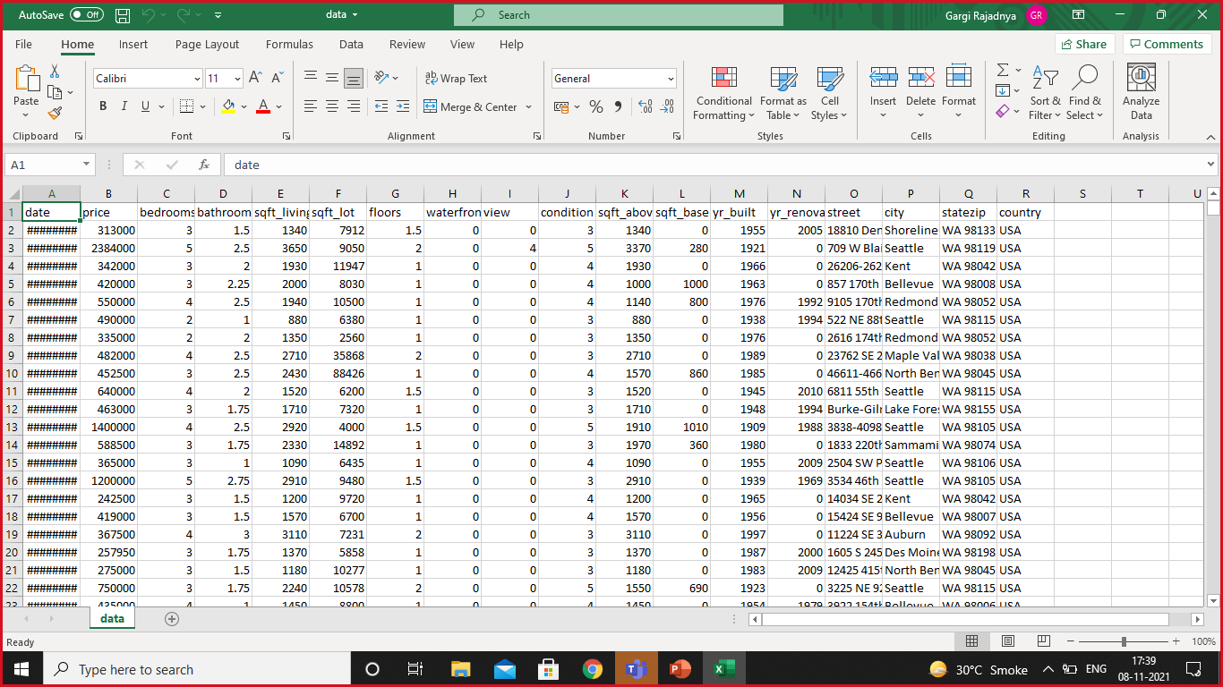
FACTORS
The Square foot area
Number of bedrooms
Number of bathrooms
Neighbourhood
Year Built…
Notes:
Prerana

Slide 7
DATA PRE-PROCESSING, FEATURE ENGINEERING & DESCRIPTIVE STATISTICS

Slide 8
DATA PRE-PROCESSING:
NULL VALUES CHECK
IRRELEVANT COLUMNS DROP
CORRELATION
REMOVING OUTLIERS

Slide 9
VISUALIZATION

Slide 10
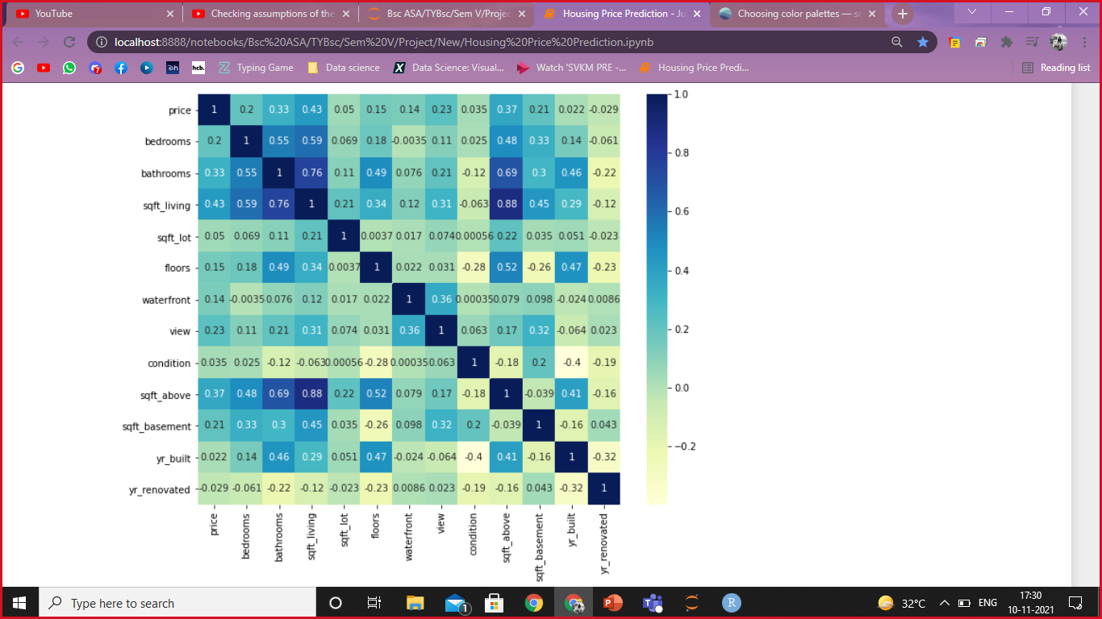
VISUALIZATION

Slide 12
FACTOR ENGINEERING
Handling zip feature
One hot encoding
Instances with prices = 0
Notes:
Prerana

Slide 13
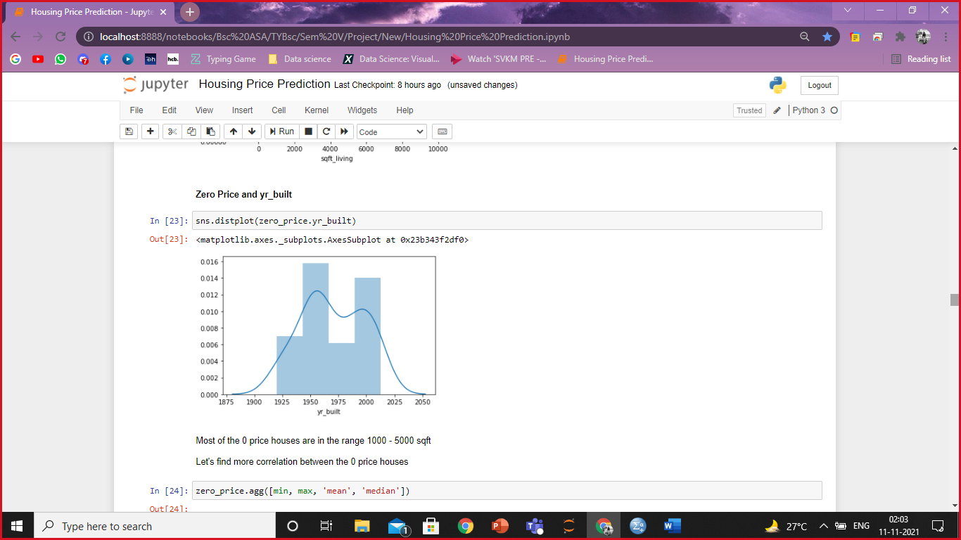
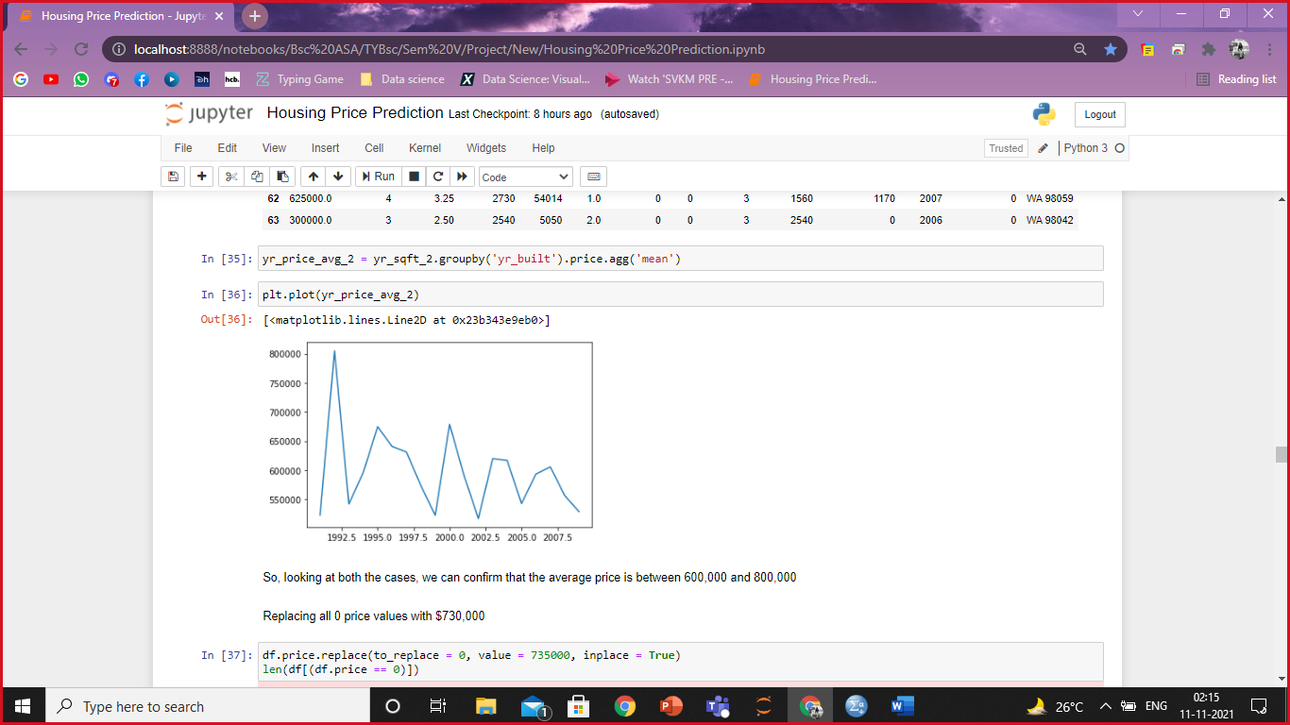
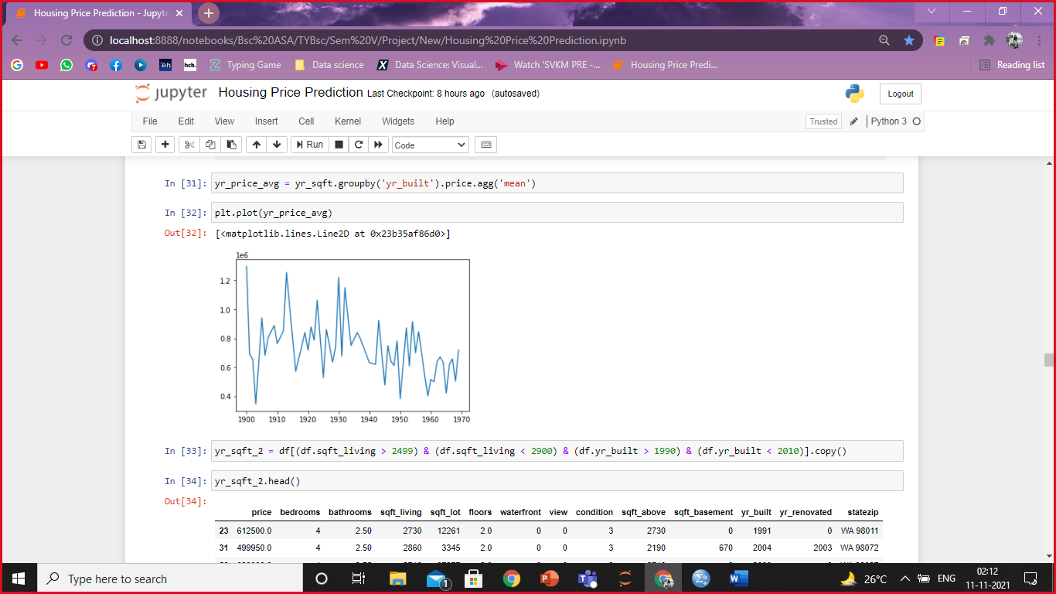
INSTANCES WITH PRICES = 0
MINIMUM, MAXIMUM, MEAN AND MEDIAN OF ALL THE FACTORS OF INSTANCES WITH PRICE = 0
Mean Price: 735475.0370

Slide 14
PREDICTIVE MODELING

Slide 15
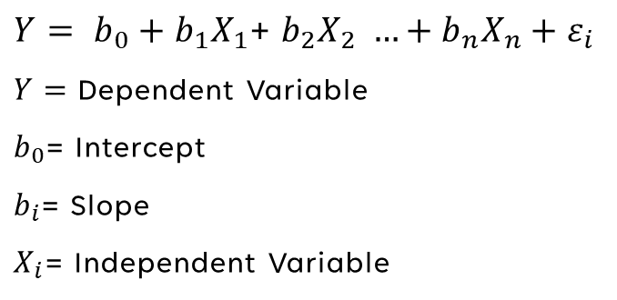
MULTIPLE LINEAR REGRESSION
EXPLANATION
EQUATION
Linear approach for modeling the relationship between a dependent variable y and multiple
explanatory(Independent) variables X
Notes:
Prerana

Slide 16
ASSUMPTIONS
Linear relationship
Multivariate normality
No or little multicollinearity
No auto-correlation
Homoscedasticity
Notes:
Prerana

Slide 17
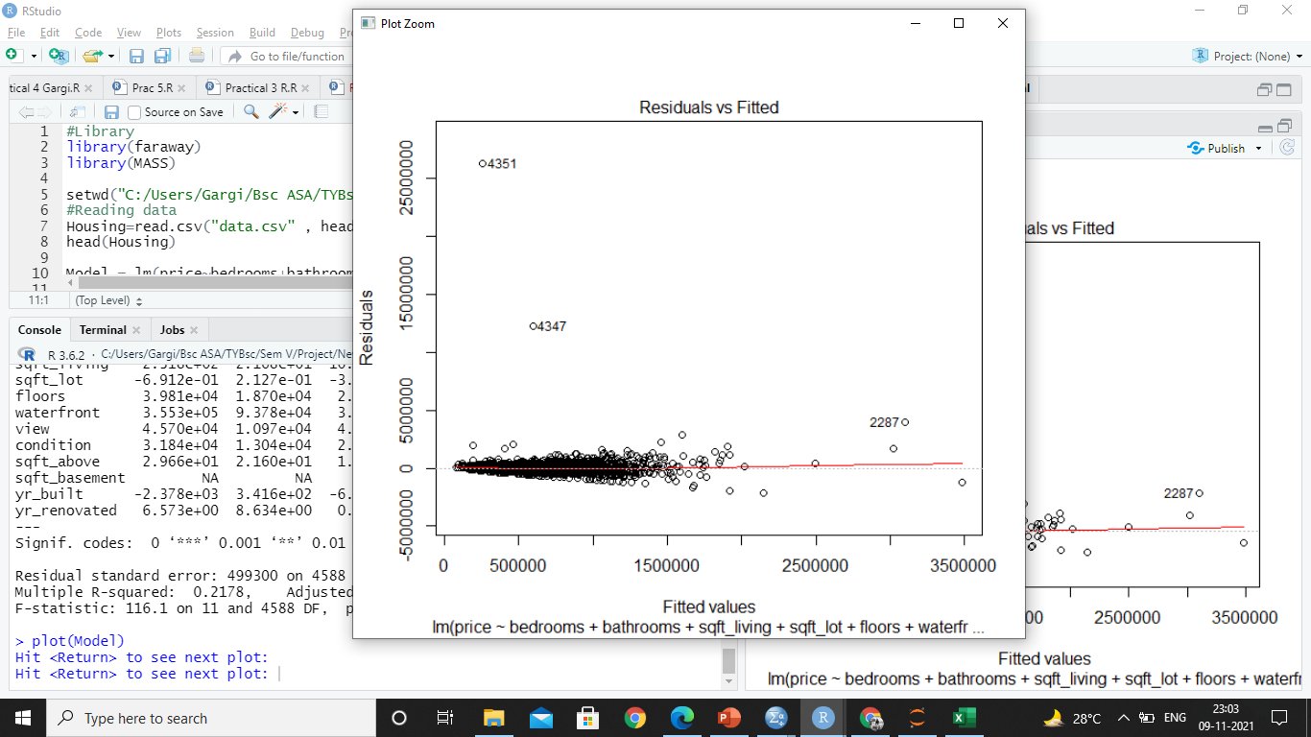
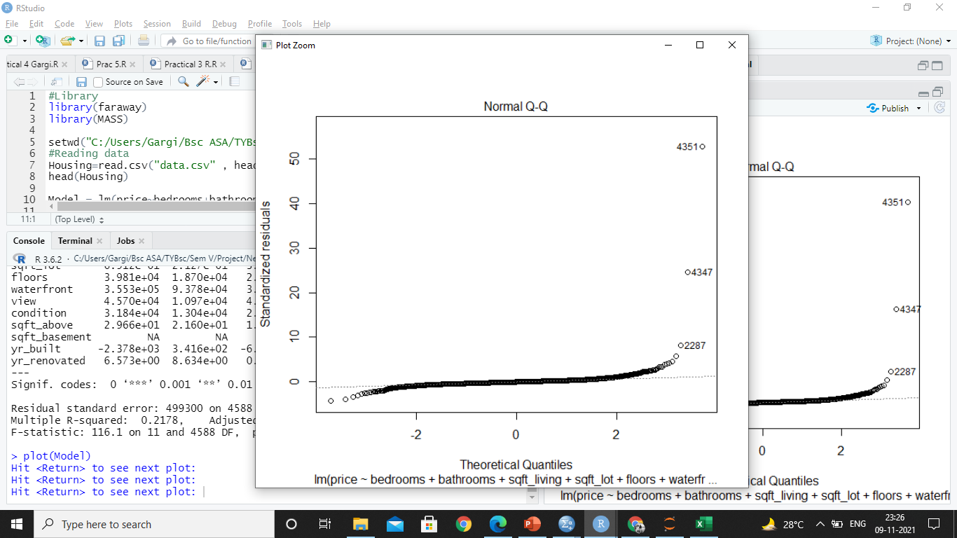
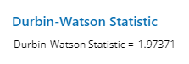
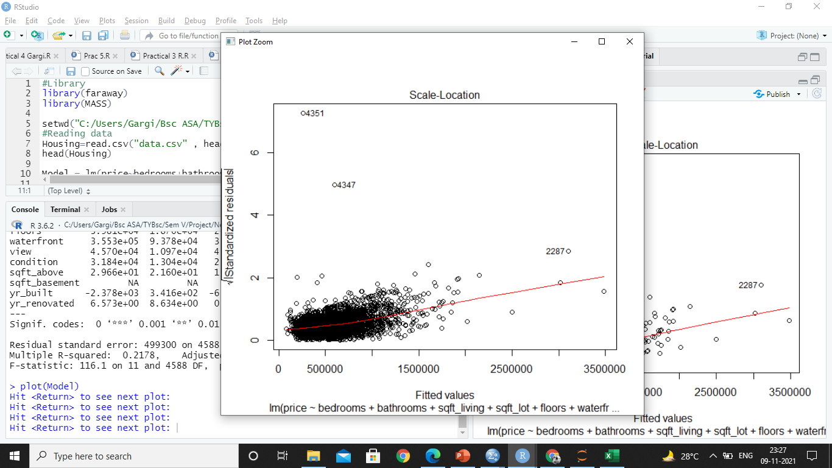
WHY NOT MLR?
Term | VIF
Constant
bedrooms | 1.68
bathrooms | 3.28
sqft_living | 8.05
sqft_lot | 1.07
floors | 1.87
waterfront | 1.16
view | 1.34
condition | 1.44
sqft_above | 6.40
yr_built | 1.90
yr_renovated | 1.32
Linearity: Disperses at the ends indicating no linearity
Normality of the errors: Seems to go off at the ends.
Autocorrelation: Exists.
Homoscedasticity: should be a straight line
Multicollinearity: Not Exists.
Notes:
Prerana

Slide 18
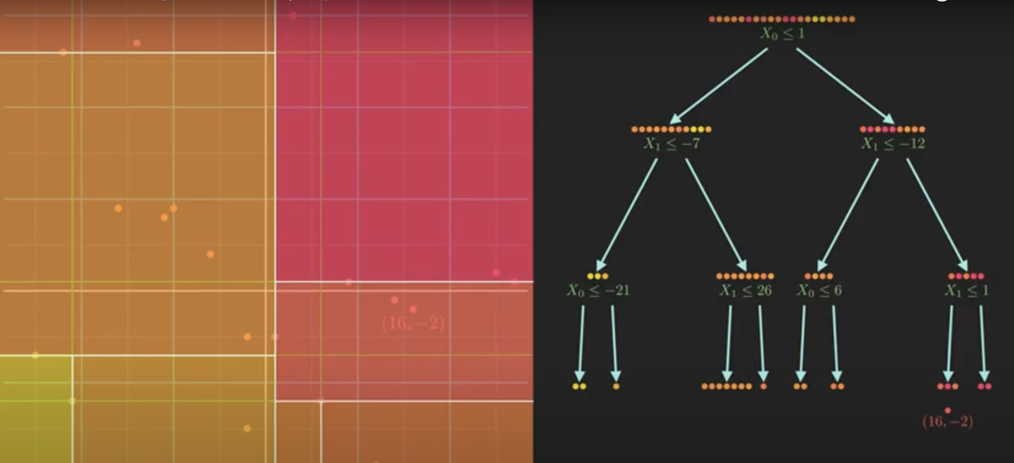
DECISION TREE REGRESSION
What is Decision Tree
Why did we use it
Parts of the Tree
Working behind the Tree
Defining Impurity

Slide 19
PROBLEM ANALYSIS
Pre- Processing
Splitting the dataset into the Training set and Test set
Importing Libraries
Importing the dataset
Defining Independent and dependent variables.
Modeling
Comparing the Real Values with Predicted Values
Training the model
Predicting the Results
ACCURACY: 0.999948
RMSE: 1901.56792

Slide 20

RANDOM FOREST
ACCURACY: 0.999993
RMSE: 712.5428

Slide 21
CONCLUSION

Slide 22

CONCLUSION
Linear Regression not possible
Decision Tree Regression Rmse score: 1901.56792
Random Forest Rmse score: 712.54
Random Forest a better option

Slide 23
TOOLS USED
Python
R Programming
SPSS
Minitab

Slide 24
BIBLIOGRAPHY
https://www.kaggle.com/ghulamhaider0123/predicting-the-house-price-using-linear-model/data
https://towardsdatascience.com/machine-learning-basics-decision-tree-regression-1d73ea003fda
https://www.youtube.com/watch?v=v6VJ2RO66Ag

Slide 25



MEET THE TEAM
Gargi Rajadnya
75252019019
Maryam
75252019003
Prerana
75252019003

Slide 26

THANK YOU
LinkedIn links-
Gargi Rajadnya
Maryam Amir Ahmad
Prerana Sahu

